Slide 1
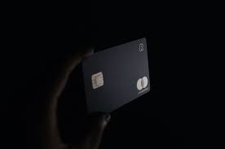
RACKATHON - 2021
CREDIT CARD FRAUD DETECTION
& PREVENTION
THEME – FINANCIAL TECHNOLOGY
- By Team Core_dumped
(Members)
Harshit Jain
Swarnendu Ganguli

Slide 2

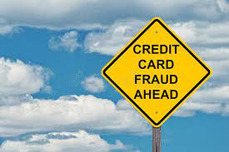
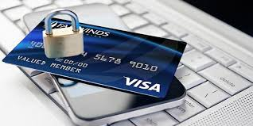
What is Credit Card Fraud..?
Credit card fraud is considered a form of identity theft. Credit card fraud happens when someone — a fraudster or a thief — uses your stolen credit card or the information from that card to make unauthorized purchases in your name or take out cash advances using your account.

Slide 3

Objective…!!
Our main objective is to recognize fraudulent credit card transactions so that the customers of credit card companies are not charged for items that they did not purchase.
Also to reduce the heavy losses of merchants and financial institutions which are caused due to insecurity of the customers towards the credit card frauds.

Slide 4


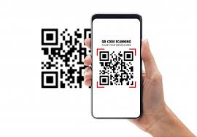
Our Approach…!!
Machine Learning
2) 2-way Authentication using Facial Recognition
3) QR Code authentication using Blockchain

Slide 5


Some of our Tools & Technologies…..
Django Web Framework
Machine Learning Models
OpenCV
Face Recognition
Cryptography
QR Codes
Basic Blockchain

Slide 6

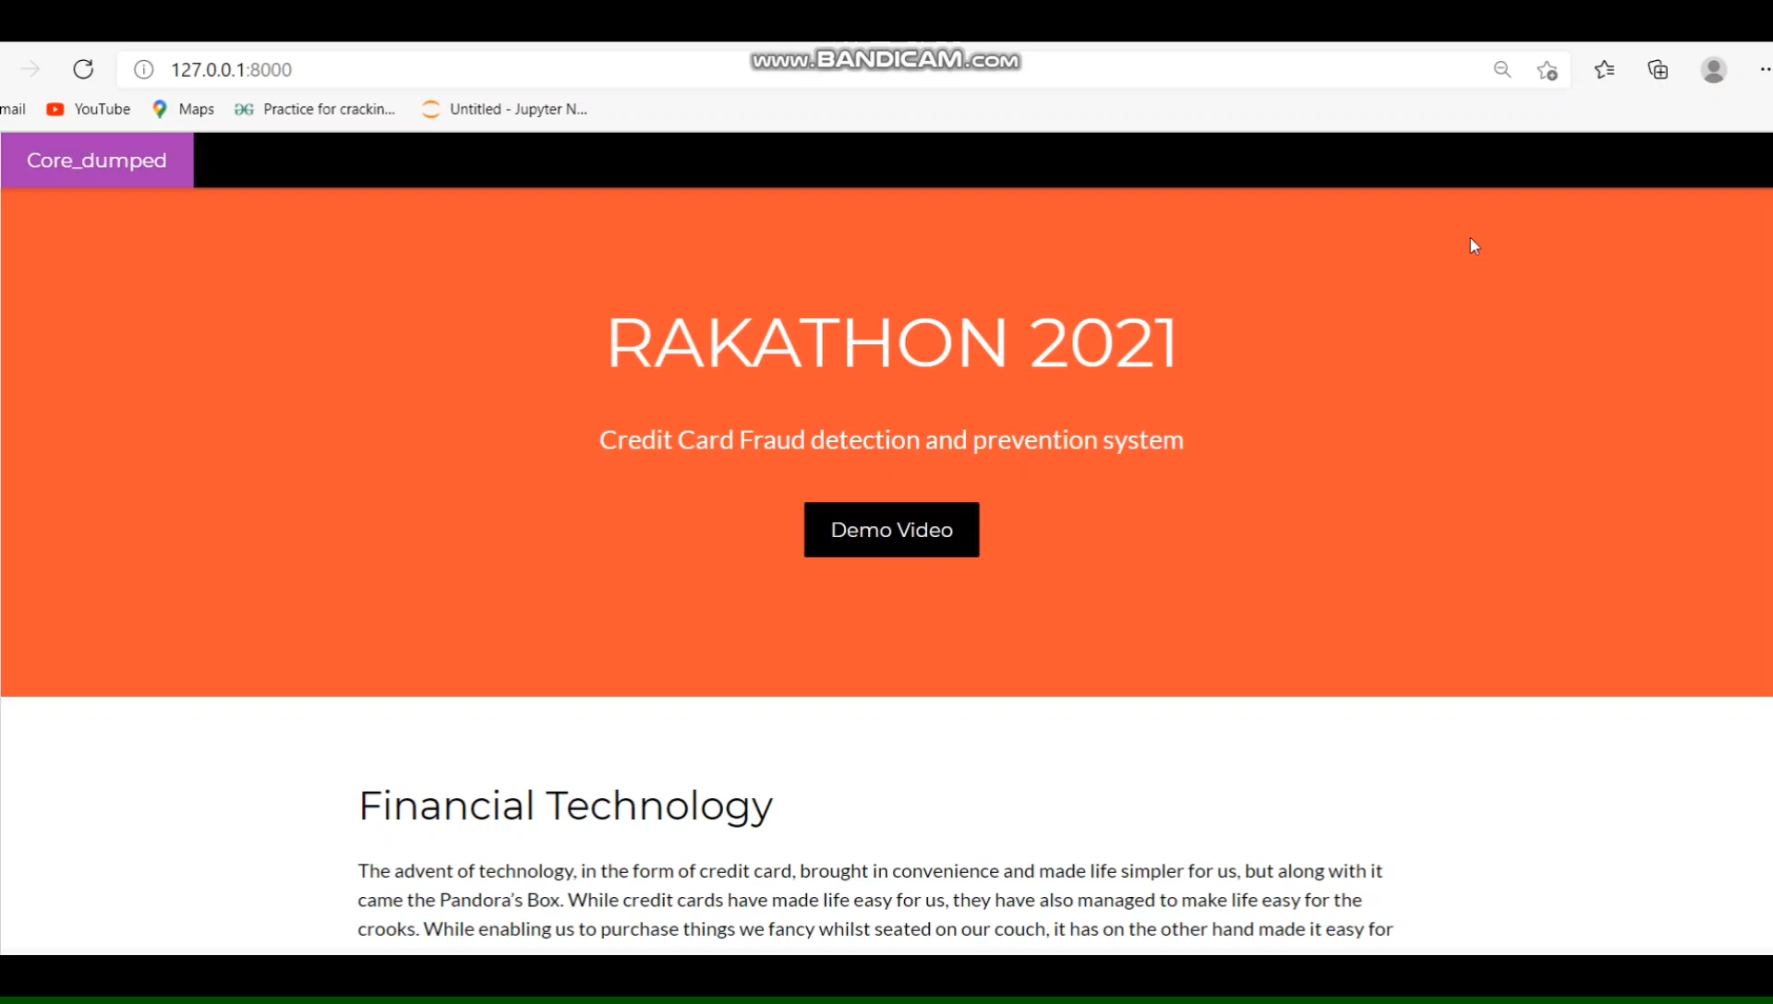
Demo Video of our website…

Slide 7


